Slide 1




Parents’
Information
Evening FOR
Year 6
Learning Together In God’s Love.
Wednesday September 14, 2022
Welcome and Good Evening

Slide 2
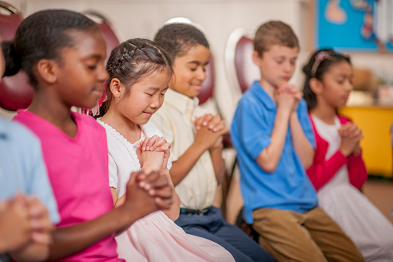

Opening Prayer…LET US Pray
In the name of the Father…
Lord, let your Spirit of Mercy and Compassion fill us all and teach us your ways. Help us all to strive to become more like you. Inspire us to look to you for guidance with raising and teaching our children. Help each of our children to enjoy their learning and take delight in new discoveries. Help them to persevere in their studies and give them the desire to learn all things well with the support of us- their parents and teachers.
Bless the staff as they share their knowledge with gentle patience and endeavour always to bring the truth of your word to eager minds. Grant that we -students, staff, parents and carers may look to you Jesus - the way, the truth, and the life, in this New Academic Year today and for ever. Amen.

Slide 3
Staff Introductions- Year 6
Mrs Moore – Head Teacher
Miss Wade- Deputy Head, Whole School Curriculum Lead & Phase Lead for KS2 (3-6)
Mrs McDonald - Assistant Head, Assessment Lead & Phase Lead for KS1 (1&2)
Miss Baptiste – AAHT,SENCO/Inclusion Manager, Transition Lead KS2 & EYFS Lead (MAT Cover)
Mrs Uthman- Year 6 Class Teacher -Almond
Mrs Vivian Oforiwaa- Yr. 6/KS2 Teacher
Miss Hussein- Yr. 6 Teacher/Art& DT –KS2
Mrs Radia-HLTA/ Yr. 6 Interventions

Slide 4
Aims of this meeting
To introduce you to the Leadership & Year 6 Team
For Staff To Meet and Induct Year 6 Parents
Share salient schools policies and procedures
Share school expectations for year 6
To Discuss The RSHE Curriculum: TEN TEN
Review of behaviour management across Yr. 6
To review the home/school agreement
To discuss year 6 Transition To Secondary School
To discuss plans for year 6 end of your events
To meet your year 6 Teachers

Slide 5
Our School Motto:
Learning Together In God’s Love
Our School Council -Pupil Leaders To Be Elected This Term
Head Boy & 2 Deputy Head Boys
Head Girl & 2 Deputy Head Girls
5 House Captains and 2 Vice Captains each
Prefects
Their role is to be the living example of what it means
to be a positive, productive and progressive pupil at St Antony’s. The roles are about giving generous service to school & community … it is not a crown or badge
They are required to : LEAD BY EXAMPLE IN BEHAVIOUR,
WORK ETHICS, ATTITUDE AND APPROACH TO LEARNING
Those interested must write a letter stating why they
should be elected to persuade the children and staff

Slide 6

Our Golden Rules
I will respect everybody and
everything at all times
I will keep myself and others
safe at all times
I will follow instructions
immediately at all times.
I will work hard, listen keenly and do my best in all things at all times……..
By following these rules we:
LEARN TOGETHER IN GOD’S LOVE
LISTEN……THINK ….REMEMBER…..PRACTISE

Slide 7
Behaviour Management
  Positive behaviour management is used
  right across the school at St Antony’s.
  All pupils begin each day ‘ON TRACK’
    Praise, points, rewards, certificates are given for staying on track through the day.
    If a pupil does not behave or follow instructions
    They are given a verbal caution
    If the inappropriate behaviour continues their name is moved to CAUTION ON THE BOARD
    If the wrong behaviour persists the pupil is put on RED ALERT! Resulting in time out or the pupil sent to an SLT member (Head/Deputy/AHT)
    In extreme circumstances or for habitual repeated infringements parents are called in. A programme to remediate the behaviour pattern is put in place.

Slide 8
Expectations Of Year 6
Must come in with A Positive Attitude to Learning
Take RESPONSIBILITY for All Actions
Be prepared for SATS 2023- MAY 8th-12th
Engage With Full Participation in class daily
Do not be a distractor or being distracted
Must Complete Homework-Parents Please Ensure!
Have A Clear Structure at Home-get enough sleep
Use game consoles/I-pads/Laptops as Rewards/Research
Use all devices safely-practice e-safety. NO PHONES
Work on penmanship & spellings & Learn X Tables
READ EVERY DAY AT HOME FOR AT LEAST 20mins
Participate In School Based & Community Programmes
Serve the School & Church-Lead The 10am Mass

Slide 9

School Procedures For Yr 6
School starts at 8.00 am promptly for Yr. 6 each morning! 98% (58) of our pupils get here on time daily for year 6 morning boosters/HW currently. Is your child in the 2%?
Absences & Lateness are strictly monitored as these are indicators of a range of issues. We will call home.
Year 6 Attendance so far has been average 98% …on average 2% of pupils have been absent for 1or more days.
Year 6 Target for Attendance and Punctuality:100% daily
Home Work is checked first thing each day- we have a few children routinely NOT completing HW- Do you check?
Knowing Times Tables is still not as it should be as only 80% (46) know their times tables off by heart. Start working
Spelling is still a weakness for some-practise daily!
Handwriting and presentation for many still needs improvement: so practise, practise, practise!
.

Slide 10
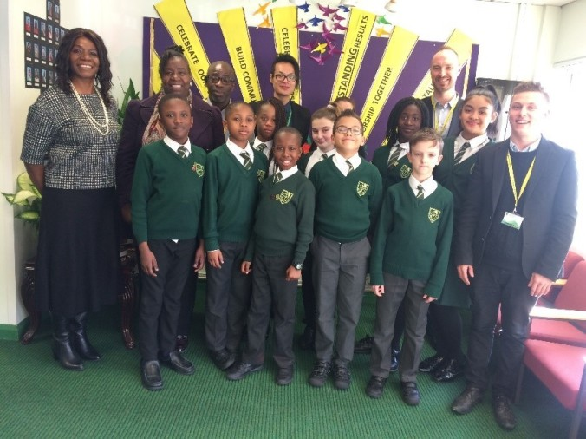
School Procedures
Holidays in term time are not allowed as the Government and Newham Borough clearly stipulates ~ Families are expected to take breaks during the normal 13 weeks of school holidays.
Correct School Uniform: must be worn daily.
Always Check for information up-dates on Class Dojo.
All uniforms should be labelled. Lost uniforms are
returned if labelled. Mrs Samuels and staff can be
contacted regarding lost property.
Any Concerns ~ Discuss issues relating
to your child initially always with their class
Teacher as they know your child best.
If you are still unsure then speak with Miss Wade or Miss Baptiste of the School’s Leadership Team.

Slide 11
School Procedures continued…
A Written, Dojo or Text Notice is given for any meetings, trips, events or procedures planned. If event/programmes need to be postponed or cancelled or to inform of any other changes needed (Normally at least 24 hours notice).
The Newsletter has all the dates for each half term.
Only Year 5 & 6 pupils are allowed to make their own way home
but only with written permission to do so from parents.
If you have not already done so please send this letter in-signed & dated. They are not allowed to take younger siblings home
The annual School Improvement Fund is £30 per family. This can be paid in one amount for the year or in termly instalments of £10. Our Newsletter informed all of this payment.
Pupil absences must be reported as soon as possible and a written note provided upon the child’s return. Absences of more than a week need a medical certificate or other hard evidence explaining why.
COVID-19 is still a factor we must manage effectively. If any parent or child has COVID it must be reported to the school and the necessary period of isolation served until all test negative before returning. Proof of negative test must be provided.

Slide 12

Parent EXPECTATIONS requirements
To actively support the school’s behaviour policy in an effort to ensure that all our children, staff and parents are safe.
To dress appropriately when coming into school
To model high standards of appropriate behaviour and use of language for our child/children to emulate
To approach/ speak to staff in a respectful, calm and courteous manner at all times: at the gates (am/pm), in meetings etc.
To deal with any matters with staff/other parents in a mature and appropriate manner and not engage in any verbal or physical confrontations on school premises- apply correct procedure appropriately
To bring matters of concern to the attention of the relevant Staff, Phase Leads or the Head Teacher.

Slide 13





WHAT IS RHE: TEN TEN?
IT IS THE NEW RELATIONSHIP,HEALTH EDUCATON CURRICULUM FOR ALL CATHOLIC SCHOOLS SANCTIONED BY THE DFE, CES &DIOCESE
IT IS BASED IN CATHOLIC FAITH TEACHING ABOUT FORMING AND MAINTAINING HEALTHY RELATIONSHIPS AND TREATING OUR BODIES WITH
THE RESPECT IT DESERVES…’’Bodies are Temples’
THIS CURRICULUM IS BEING TAUGHT FROM EYFS
TO YEAR 6 AND COVERS WHAT WAS FORMERLY
TAUGHT USING JOURNEY IN LOVE

Slide 14
Home School Agreement
Year 6 Transition, Trips, pay+
You all have a copy of the Home/School Agreement to read, sign and hand in today
Your Year 6 Transition Book is being issued today please read it fully then choose the schools you will be applying for carefully & complete your application and submit before October 31st -22.
PAY+ …PARENT PAYMENT SYSTEM IS CHANGING TO
SCHOOL PING- Our School Business Manager to detail
We encourage you all to take the opportunity to officially join the PTFA Body- Information will be sent to you via Class Dojo/Letter with dates

Slide 15
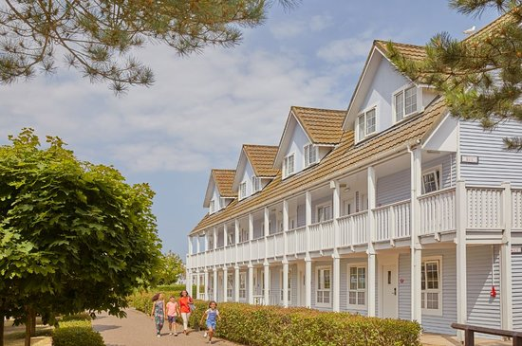
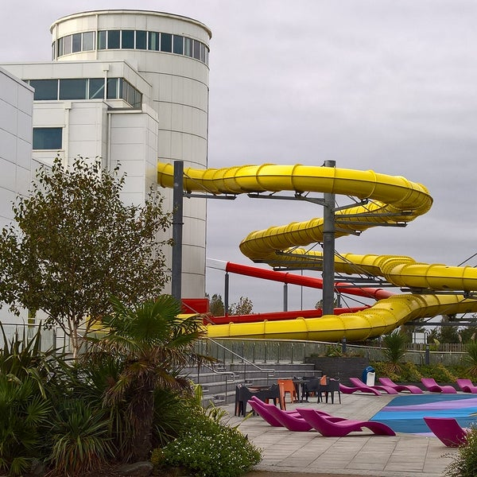

YEAR 6 TRIPS & Events 2023
Year 6 will be going on a number of trips directly linked to their learning and others as rewards for hard work after SATS:
5th June –Time Away @Butlin’s Resorts for all inclusive 3 days 2 nights- Letters to come
28th June- LBN Transition
3rd July -Bosco Day OLOG
7th July- Chessington Trip
Year 6 Souvenir Hoodie/Zoodie- Leavers Keep Sake To Be Ordered

Slide 16

Part II
Short Discussion With Your Child’s Teacher
Find out about what how your child is settling in so far
Find out about daily routines and class expectations
Find out about Homework, PE and other class arrangements
Learn about possible educational visits for the year
Chance to ask the teacher questions
Year 6 Memorabilia- Leavers Hoodie

Slide 17

Thank you for attending tonight’s meeting.
Learning Together In
God’s Love.

Slide 18
St. Antony’s CATHOLIC primary School
Learning Together In God’s Love

