Slide 1
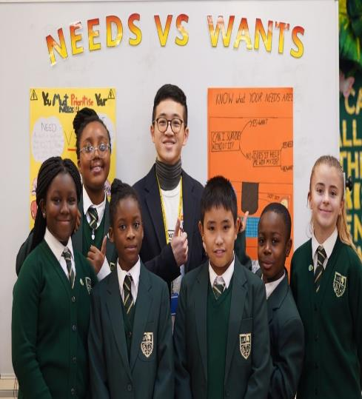
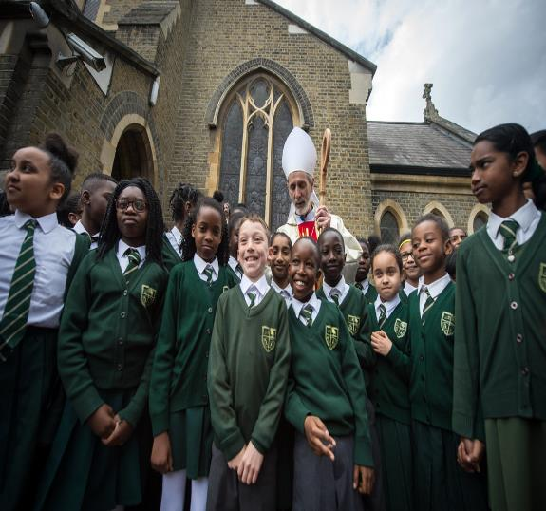
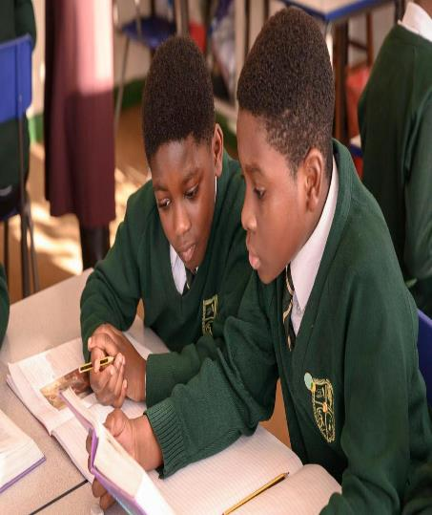
St Antony’s Catholic Primary School Staff Review On
Relationships, Sex and Health Education (RSHE)

Slide 2
OVERVIEW: Why Was RSHE Placed In The Curriculum?
The New Curriculum for Relationships Health and Sex Education was made mandatory from September 2020 in all schools across the country. The DfE requires all schools to have this curriculum in place.
Primary schools must teach RHE- Relationships and Health Education, including education on mental Health & Wellbeing.
Secondary Schools must teach Relationships, Sex Education and Health Education.
Primary schools are not required to teach sex education.
How will this new curriculum be taught in Catholic Schools?

Slide 3
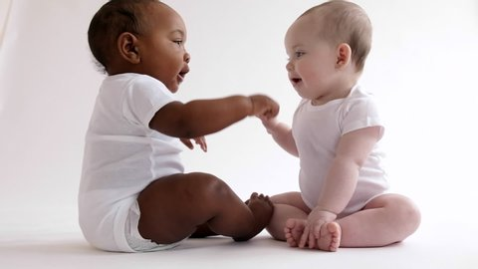
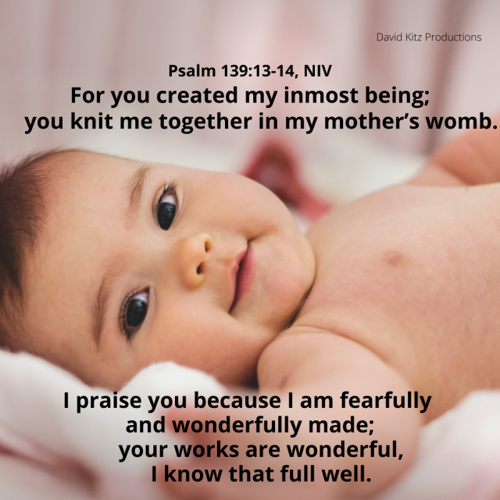
RSHE Is Being Taught In The Context Of The Religious Character of our Catholic School following 10 Core Principles.
OUR BODIES ARE GOOD: WE ARE WONDERFULLY MADE
“Before I formed you in the womb I knew you” Jerimiah 1:5-7. Our children will know they are loved by God and us just as they are because every part of their bodies was created by God in His infinite wisdom.
2. We are all Made In The Image Of God Body and Soul, Physical and Spiritual.

Slide 4
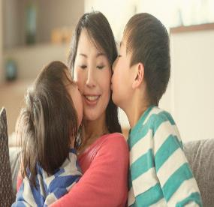
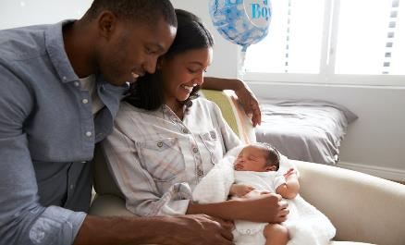
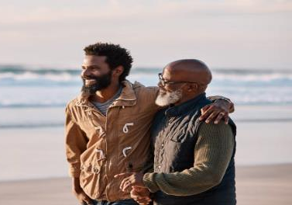
RSHE Will Teach Our Children About How To Establish Healthy Relationships
3. RSHE is about the WHOLE PERSON-SOCIAL, MORAL, SPIRITUAL AND CULTURAL. As Humans, We Are Social Beings Who Live In Relationships From Birth To Our Adult Life.
Through our loving relationships we become close to each other and close to God. GOD exists in community and in a close relationship just as we do. God Is Three Divine Persons In One- This is The Holy Trinity: Father, Son and Holy Spirit based in a loving relationship. We will teach our children about who God is and how they relate to God in their own authentic loving relationships with family, friends and with God.

Slide 5
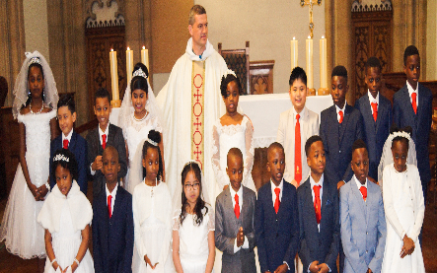
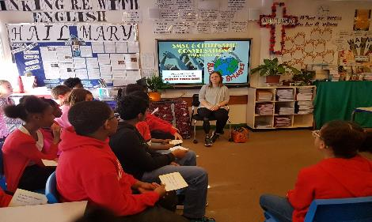
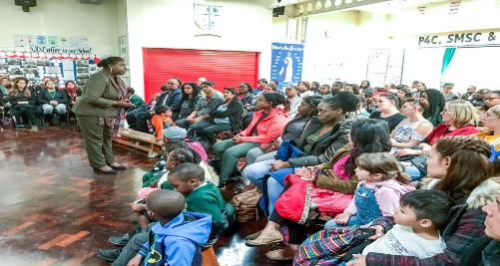
In RSHE Our Children Will Know they are special in line with our core principles.
4.RHSE will be taught in PARTNERSHIP WITH PARENTS as the school will complement what parents (first teachers) teach their children at home about themselves, their Family, Culture, Faith and Heritage at home- Celebrating Our Diversity and Commonality as human beings
5. Our Greatest Identity is That We Are Each A Child of God. Children should understand who they are as children of God knowing why they are loved and accepted by God and by us. RSHE will secure children’s sense of identity, building their self-image, self-esteem and self-worth.

Slide 6
RSHE will be taught in line with the religious character of our school
6. Children will explore the SIGNIFICANCE OF STORIES used when teaching RSHE - using scripture and parables will reveal messages that change our hearts and minds.
7. Catholic RSHE is an EDUCAION IN VIRTUES. Virtues are the habits gained through imitation of Jesus and good role models. Based on Theological Virtues of Faith, Hope, Love and the Cardinal Virtues of Wisdom, Justice, Fortitude &Temperance.
8. Catholic RSHE is AN EDUCATION IN CONSCIENCE. Children will explore that God has a purpose for their lives and the gift of conscience is God’s constant presence with them to give them guidance throughout life-to aid with making right choices.
9. Children will learn -RE and RSHE are about STRIVING FOR THE COMMON GOOD (Ladauto Si & Fratelli Tutti)- Taking Care of our Neighbours locally and globally.
10. All will learn that their engagement with Prayer, Scripture and the Sacraments underpin their Relationship with God and others and will strengthen their faith.

Slide 7
Our RSHE Curriculum 3 CORE THEMES
Our RSHE curriculum is based on three core themes which are very adaptable to the age and ability of our pupils.
The three themes are embeded through Education in Christian virtue, religious understanding and RSHE.
Created And Loved By God: Explores the children’s relationship with God
Created To Love Others: The children's relationship with others
Created to Live In Community: The relationship between the children and the wider world.

Slide 8
The Curriculum Outline: Topics To Be Covered Over Time
Building character
Kindness
Consideration
Respect
Honesty/Truthfulness
Permission seeking/giving
Personal privacy
Boundaries
Inappropriate contact
Unsafe physical contact
Online safety/ boundaries and sharing images.
Resilience
Self-belief
Perseverance
Developing goals
Integrity
Courage
Humility
Generosity
Sense of justice
Recognising and reporting abuse
Rights over their own bodies.
What a relationship is
What a friendship is
What family means
Healthy friendships
Family relationships and structures
Happiness and security
Seeking advice
Staying safe
Trusted adults

Slide 9
Extracts from the DfE Guidance on RHE for Primary & RSHE for Secondary
To embrace the challenges of creating a happy and successful adult life, pupils need knowledge what will enable them to make informed decisions about their wellbeing, health and relationships and to build their self-efficacy. Pupils can also put this knowledge into practice as they develop the capacity to make sound decisions when facing risks, challenges and complex contexts. Everyone faces difficult situations in their lives. These subjects can support young people to develop resilience, to know how and when to ask for help, and to know where to access support.
High quality, evidence-based and age-appropriate teaching of these subjects can help prepare pupils for the opportunities, responsibilities and experiences of adult life. They can also enable schools to promote the spiritual, moral, social, cultural, mental and physical development of pupils, at school and in society. The duties on schools in this area are set out in legislation.

Slide 10
Important Extracts from the DfE Guidance on RSHE
The Relationships Education, Relationships and Sex Education and Health Education (England) Regulations 2019, made under sections 34 and 35 of the Children and Social Work Act 2017, make Relationships and Health Education (RHE) compulsory for all pupils receiving primary education and Relationships and Sex Education (RSE) compulsory for all pupils receiving secondary education.
They also make Health Education compulsory in all schools except independent schools. Personal, Social, Health and Economic Education (PSHE) continues to be compulsory in independent schools.
This guidance also sets out both the rights of parents/carers to withdraw pupils from sex education at secondary schools if they so desire (but not from Relationships or Health Education RHE in primary education) and the process that head teachers should follow in considering a request from a parent. Parents have the right to request that their child at secondary school be withdrawn from some or all of sex education delivered as part of statutory RSE a of September 2020.

Slide 11
Extracts from the DfE Guidance Show Schools Given Flexibility on Delivery of RHE
Schools are free to determine how to deliver the content set out in this guidance, in the context of a broad and balanced curriculum. Effective teaching in these subjects will ensure that core knowledge is broken down into units of manageable size and communicated clearly to pupils, in a carefully sequenced way, within a planned programme or lessons. Teaching will include sufficient well-chosen opportunities and contexts for pupils to embed new knowledge so that it can be used confidently in real life situations.
In all schools, when teaching these subjects, the religious background of all pupils must be taken into account when planning teaching, so that the topics that are included in the core content in this guidance are appropriately handled. Schools must ensure they comply with the relevant provisions of the Equality Act 2010, under which religion or belief are amongst the protected characteristics.
At St Antony’s, we will aim to teach RHE within the context of our values, showing respect for all cultures and faiths and underlining the importance of happy, mutually supportive and stable relationships.

Slide 12
The DfE Guidance Requires Schools To Ensure all Pupils Can Access The Content
Relationships Education, RSE and Health Education must be accessible for all pupils. This is particularly important when planning teaching for pupils with special educational needs and disabilities who represent a large minority of pupils. High quality teaching that is differentiated and personalised will be the starting point to ensure accessibility.
In teaching Relationships Health Education and RSE, schools should ensure that the needs of all pupils are appropriately met, and that all pupils understand the importance of equality and respect. Schools must ensure that they comply with the relevant provisions of the Equality Act 2010, (please see The Equality Act 2010 and schools: Departmental advice), under which sexual orientation and gender reassignment are amongst the protected characteristics.
At St Antony’s, we aim to answer our children’s questions thoughtfully and honestly, at an age – appropriate (or understanding-appropriate) level. Subjects such as homosexuality, bisexuality and transgenderism are not taught explicitly, but may come up as part of pupil led discussions, and questions will be answered by adults in a way which encourages respect, understanding, and tolerance in line with the teachings of the Catholic Church on preserving human dignity.

Slide 13
Parental Right To Withdraw Pupils from RSE
Parents have the right to and may request that their child be withdrawn from some or all of sex education lessons delivered as part of statutory RSE to years 5&6. They will have an opportunity to view all resources as TEN TEN content is placed on the website and shared in Parents’ Information Evenings. Request to withdraw must be made in writing to the head teacher. Parents however, need to be aware that the same content covered in RSHE covering puberty and reproduction are also covered in science lessons from which children cannot be withdrawn by law.
Good practice is also likely to include the head teacher discussing with parents the benefits of receiving this important education and any detrimental effects that withdrawal might have on the child. This could include any social and emotional effects of being excluded, as well as the likelihood of the child hearing their peers’ version of what was said in the classes, rather than what was directly said by the teacher.

Slide 14
The Science Curriculum is Statutory- So Pupils may not be withdrawn
Parents may not withdraw pupils from Science lessons on sex education related topics which form part of the Compusory, Statutory National Curriculum.
In KS1 - Pupils will be taught to notice that animals, including humans, have offspring (babies) which grow and change over time to adult form.
They should also be introduced to the processes of reproduction and growth in animals through exploring animals and their young. The focus at this stage will be on helping pupils to recognise growth and change.
In EYFS Children will explore life cycles of different animals such as 1. Chickens : egg, chick, chicken; 2.Caterpillar, pupa, butterfly. 3 Frogs: spawn, tadpoles, frog. 4 Horses: foal, colt, horse. Humans referring to Mothers: Baby, toddler, child, teenager, adult.

Slide 15
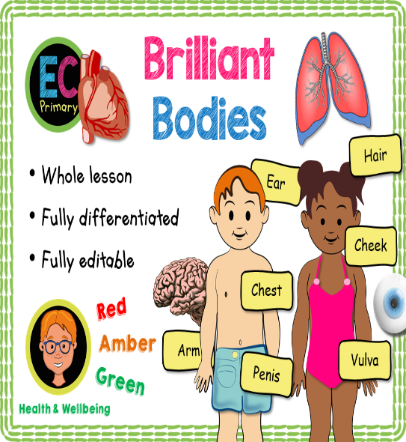
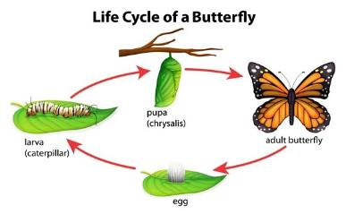
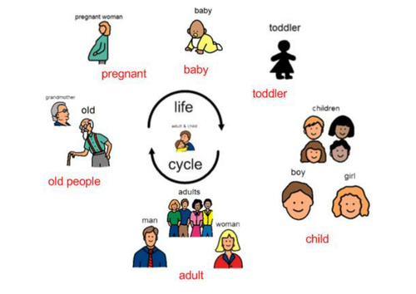
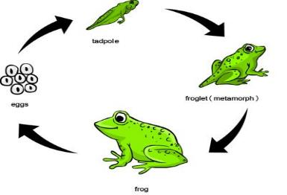
The Science Curriculum is Statutory and will include Human & Animal Growth and Development with children learning correct names for parts of their bodies
In KS1 (yrs 1&2) - Pupils will explore animals, including humans growth and change over time.
They will be introduced to the processes of reproduction and growth in animals through exploring a range of animals and their young- they are not going to be exploring reproduction as it will be done in Years 5 and 6 which will involve puberty.

Slide 16
Key Stage 2 Science Curriculum Includes the reproductive cycles
In Upper KS2 (Years 5 and 6) - Pupils should be taught to describe the differences in the life cycles of mammals, amphibians, insects and birds and describe the life process of reproduction in some plants and animals. Pupils should find out about different types of reproduction, including sexual and asexual reproduction in plants (pollenation), and sexual reproduction in animals. They might observe changes in an animal over a period of time (for example, by hatching and rearing chicks from eggs in class), comparing how different animals such as birds (chickens) and mammals (dogs) reproduce and grow.
Pupils should be taught to describe the changes as humans develop to old age. Pupils should draw a timeline to indicate stages in the growth and development of humans. They should learn about the changes experienced in puberty.
Pupils could work scientifically by researching the gestation periods of other animals and comparing them with humans; by finding out and recording the length and mass of a baby as it grows.

Slide 17
Purpose of this Consultation Process Is To Ensure That Our Parents Are Fully Informed
As a school, we would always want to continually deliver a curriculum which has the support of the vast majority, if not all, parents of our school family.
We believe that children will accept and be open to information which is given to them in small appropriate sessions over time and at an age appropriate level more readily than information which is ‘kept away’ from them until they are in Y6 or Secondary school.
We recognise that children need an increasing level of understanding, knowledge and reasoning skills to deal with the modern world and the impact of social media, social networking and gaming content aimed at adults which many children are now more commonly exposed to; as well as advertising and the media in general. Schools and parents have a responsibility to impart positive messages and lessons which build our children’s knowledge base, will power and resilience to support them with resisting the negative messages and influence they may encounter through photo-shopped body images of influencers and pop stars and TV programmes which portray sex separate from positive, healthy relationships.
We would want all pupils to grow up with the knowledge of the natural changes that they will experience before they happen as many pupils encounter puberty at a relatively young age today. For example, while the average age for a girl to begin menstruation in the UK is 12, many begin in Y6 and some in Y5. Less commonly known is that some girls can begin their periods from 8-9 yrs old.

Slide 18
Your Questions Answered: Q&A &THANK YOU ALL
Any Questions?
As part of the consultation we would appreciate your views and comments. Please complete the Google Form on- line or the hard copy issued after the meeting.
If you have any further questions you will have the opportunity to submit these with the form issued or in a short note to me or Class Teachers.
If you wish to discuss any of the points in detail, please contact the school via e-mail.

